Slide 1

Plura
Team Members: Guided By:
Mani Tyagi (2127977) (Frontend Developer) Dr. Monika Sachdeva
Prashant Sagar Shakya (2127984) (Backend Developer)
Vansh Bhandari (2127997) (Authentication & Database Manager)
Computer Science and Engineering
I.K. Gujral Punjab Technical University Mohali Campus 1
Date: 16/10/2024

Slide 2
Introduction
Plura is a next-generation website builder designed to give users the power to create highly customizable, responsive web pages with ease. Developed using cutting-edge technologies such as Next.js, Bun, Prisma, MySQL, and Clerk Authentication, Plura is tailored for users who need a flexible platform to build and manage websites, akin to WordPress but with enhanced capabilities.

Slide 3
Problem Statement
In today's digital age, creating a website is essential for both individuals and businesses. However, many existing website builders lack either flexibility or are too complex for non-technical users. Plura addresses this challenge by offering a user-friendly interface with drag-and-drop features, while also providing advanced customizability and responsive design options.

Slide 4

Objectives
Develop an intuitive website builder with a drag-and-drop interface.
Ensure high responsiveness across various devices.
Implement robust user authentication and payment gateway integrations.
Provide community support features for issue resolution.

Slide 5

Proposed Solution / Methodology
Plura's methodology is centered around the user experience, providing an intuitive drag-and-drop interface, highly customizable templates, and responsive design elements. The solution integrates modern technologies, such as Next.js 14 and Prisma, to ensure a robust backend, with Clerk Authentication and payment gateways for secure user interactions.

Slide 6
Tools & Technology Used
Next.Js 14: Frontend Framework
ADAPTABILITY
Bun: JavaScript Runtime
Prisma/MySQL: Database ORM
RazorPay: Payment Integration
Clerk: User Authentication

Slide 7
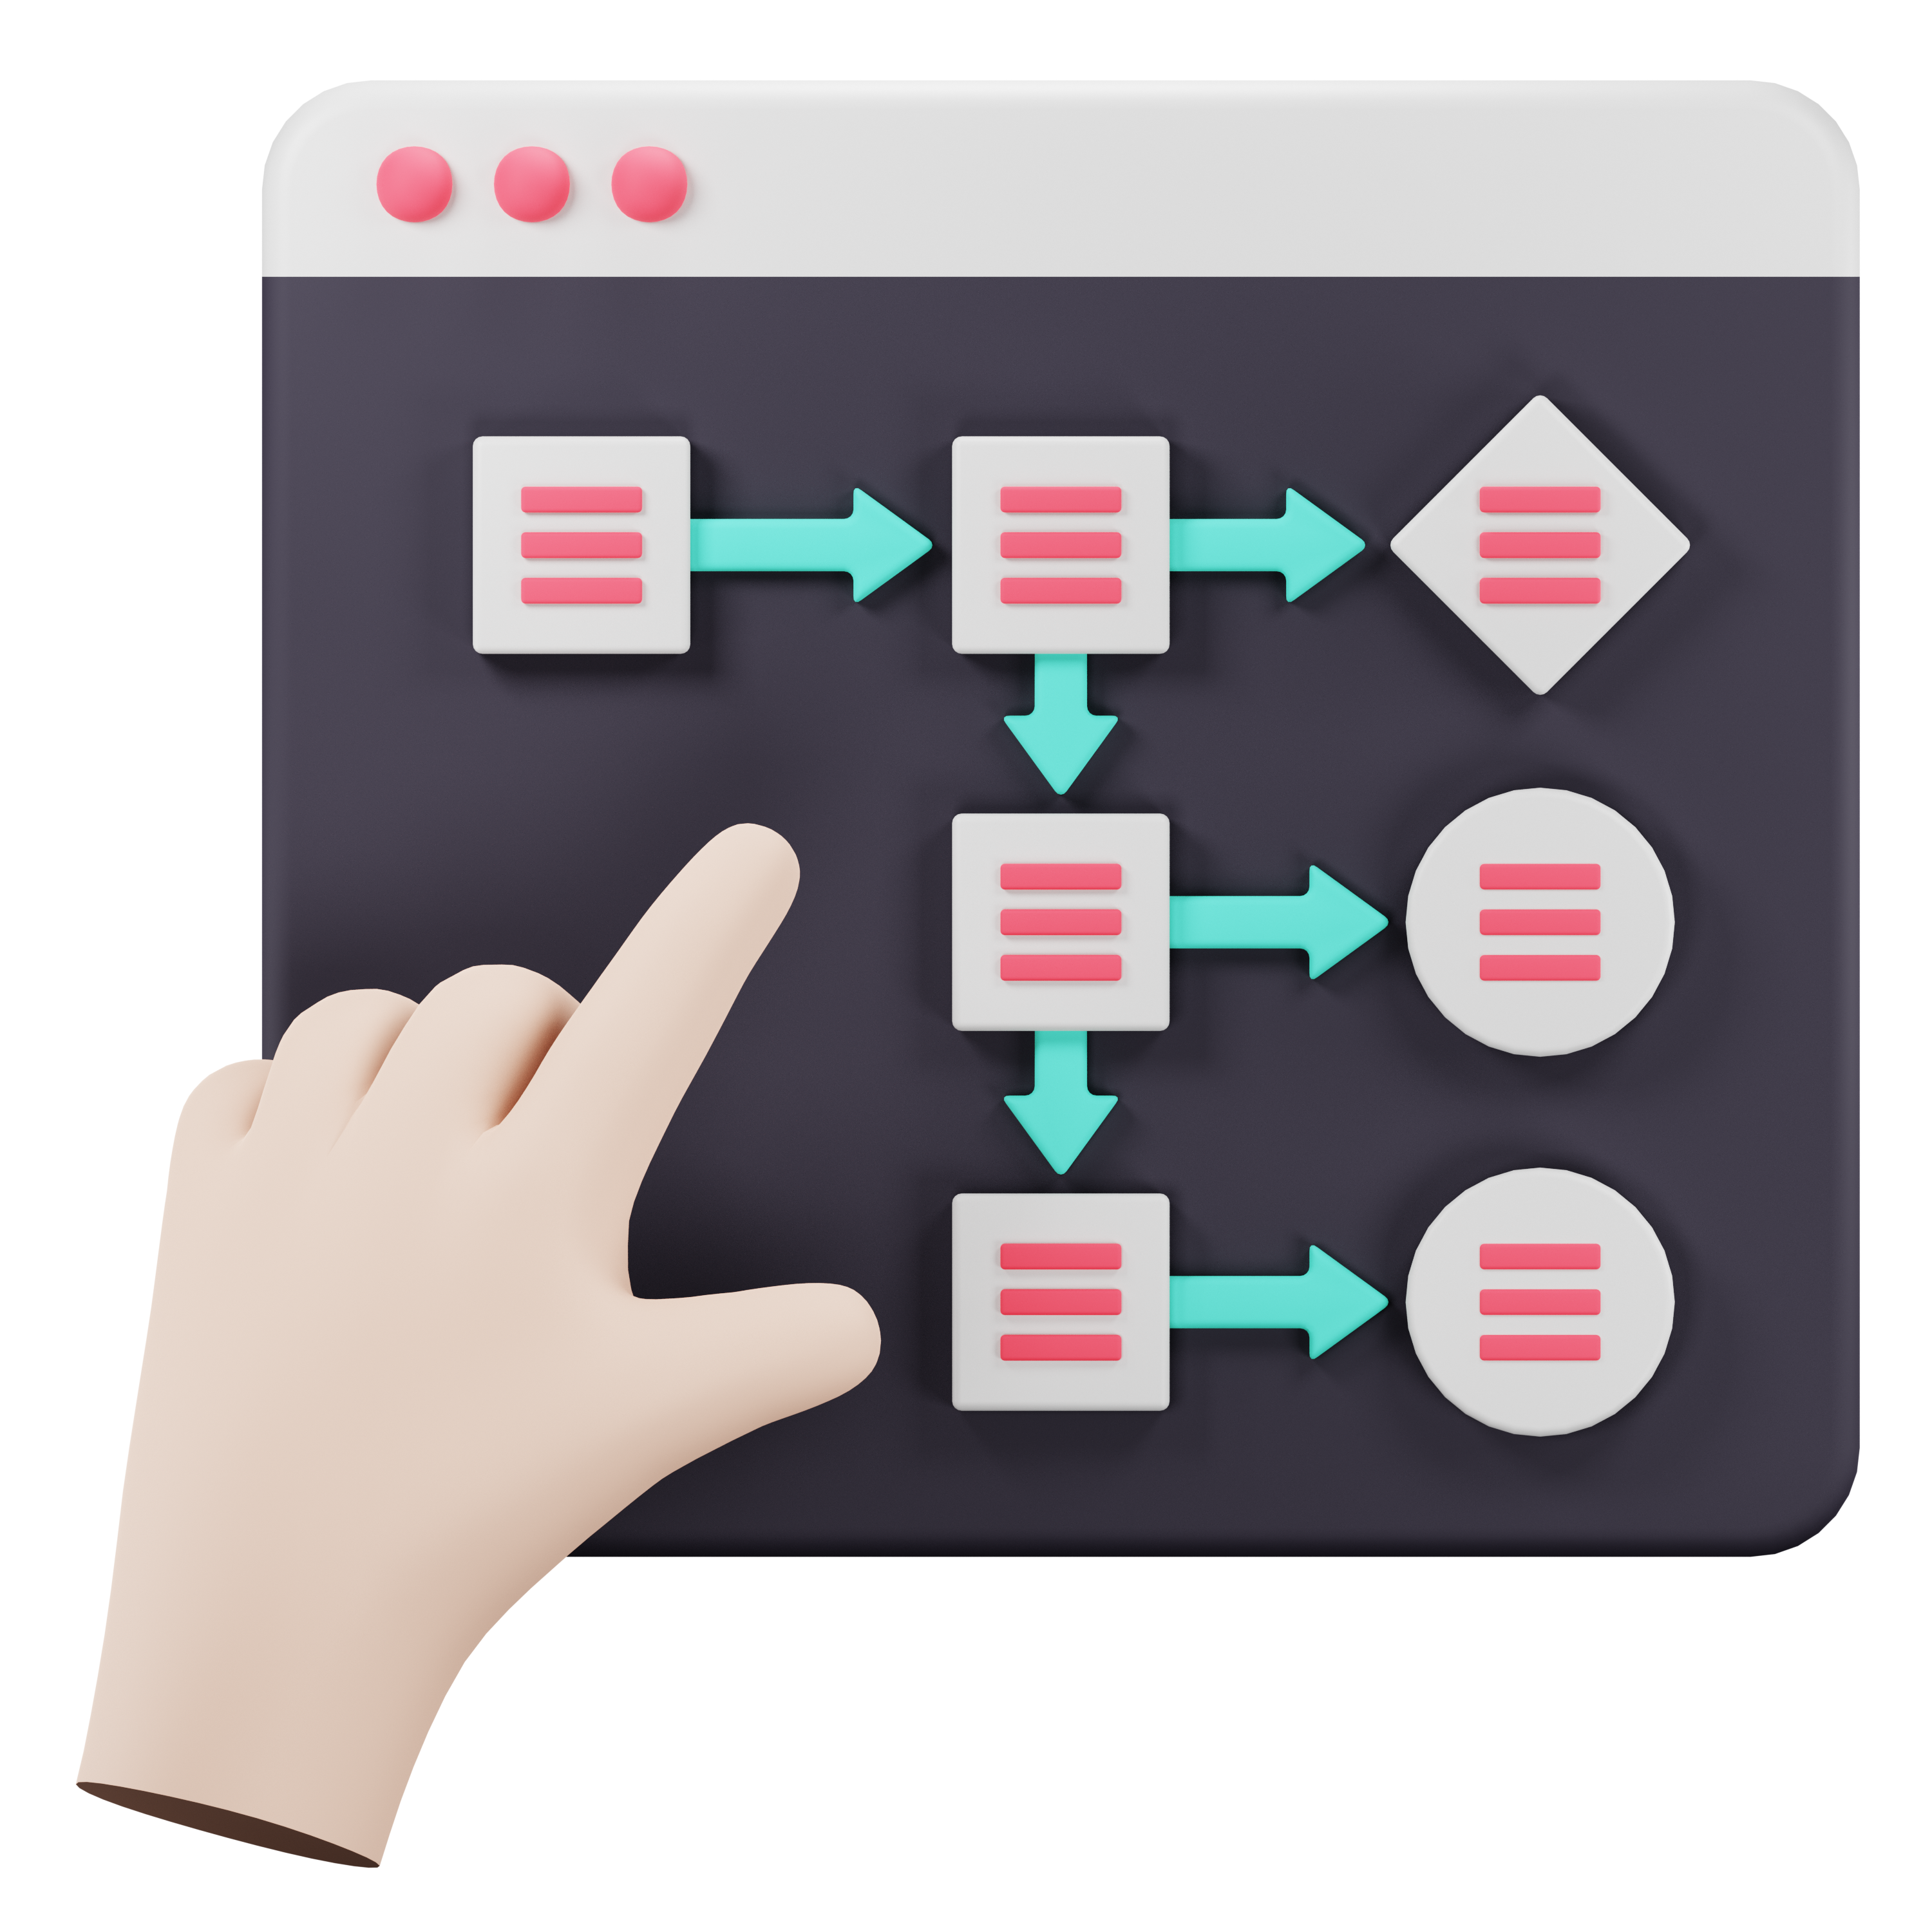
Design and Implementation Details
The design of Plura involves a modular architecture that separates concerns between the frontend, backend, and database. Data flow diagrams and ER diagrams are used to model the relationships and interactions between different components of the system.

Slide 8
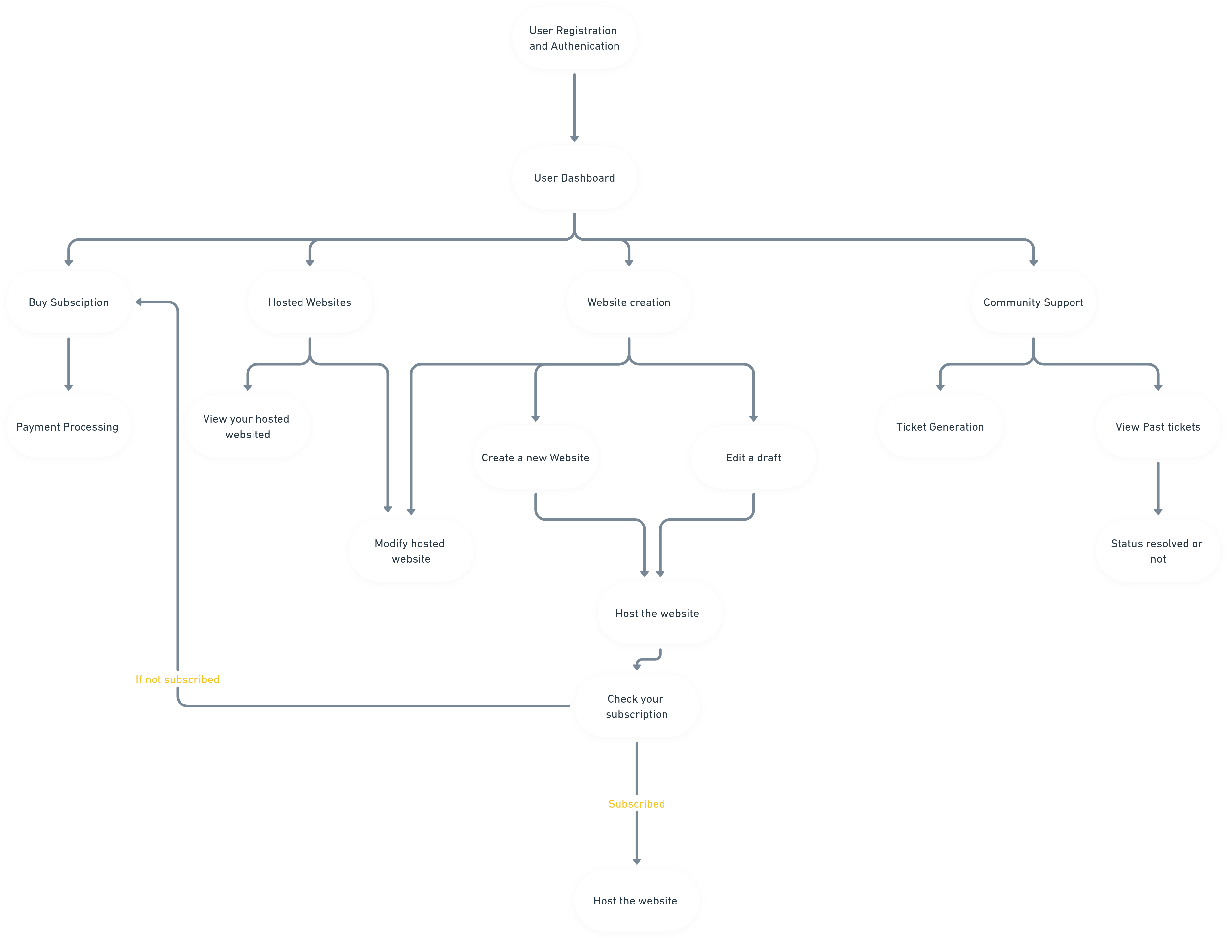
Data Flow Diagram

Slide 11
PROJECT STAGES
STEP 2
STEP 1
STEP 3
Buy Subscription and Web Creation & Hosting
A Basic Layout of Plura including User Authentication Page and Dashboard
Payment Integration to make a payment for website hosting, followed by freemium model.

Slide 12
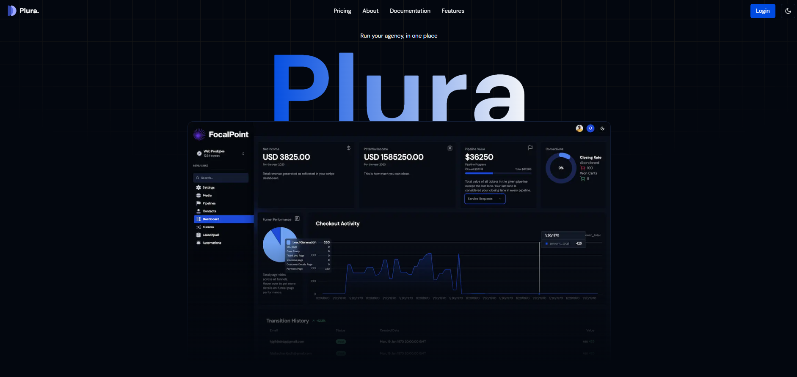
Our Achievements
Step 1. A Basic Layout of Plura including User Authentication Page and Dashboard

Slide 13
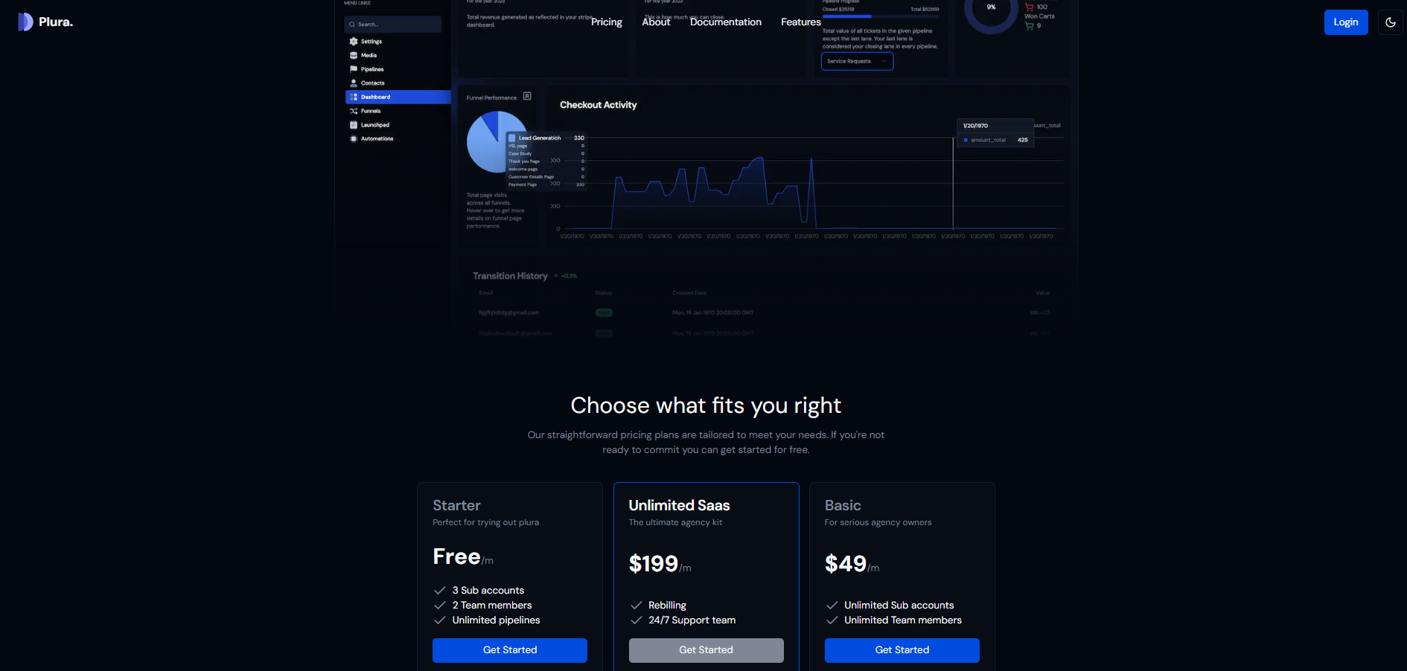


Slide 14
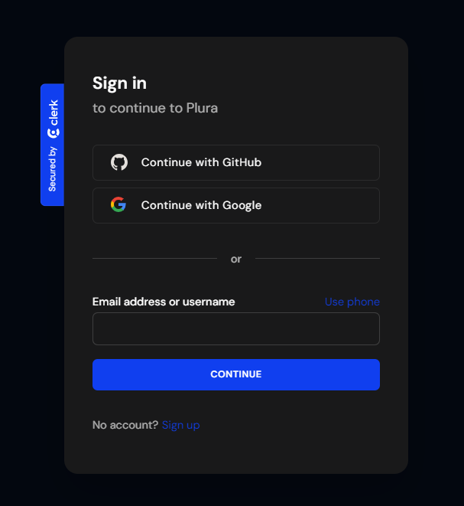
Step 2. Integrating Authentication System & Web Hosting

Slide 15
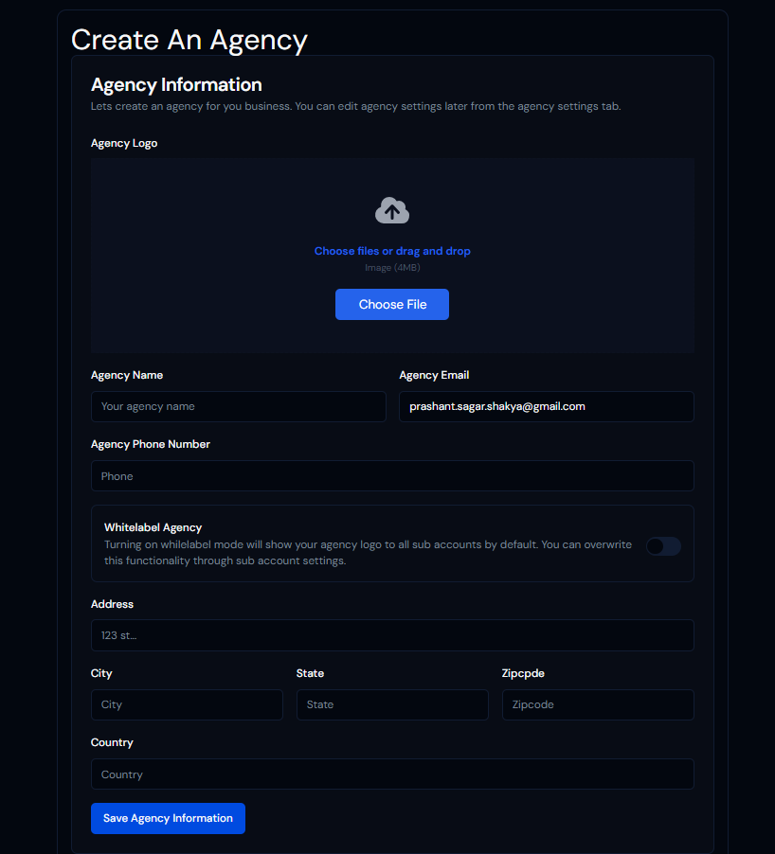

Step 3. Payment Integration to make a payment for website hosting, followed by freemium model.

Slide 16

Expected Outcomes
A user-friendly website builder with drag-and-drop functionality.
Highly responsive and customizable web pages.
Secure user authentication and payment processing.
A supportive community platform for resolving issues.

Slide 17

Conclusion
Plura aims to bridge the gap between ease of use and advanced customization in website building. By leveraging modern technologies and providing an intuitive interface, Plura empowers users to create professional-grade websites without needing extensive technical knowledge.

Slide 18
THANKS!
Does anyone have any question?

